Slide 1
Native Client
A Sandbox for Portable, Untrusted x86 Native Code

Slide 2
Outline
Problem
What is NaCl (Demo)
Related work
Solution
Evaluation
TUCAO

Slide 3
Before NaCl
Sum all numbers between 1 and 10000000
C
Golang
JS + V8
python
Notes:
js很好，但是问题在性能

Slide 4
What is NaCl
+
= CP
Notes:
C和js要是可以在一起，那就很好

Slide 5
What is NaCl
Notes:
C和js要是可以在一起，那就很好

Slide 6
What is NaCl
Notes:
C和js要是可以在一起，那就很好

Slide 7
Timing Attack: Guess One Character at a Time
Page in Memory
a
b
c
ca
…
cs
…
Page on Disk -> Page Fault
aaaaaaa
aaaaaaa
aaaaaaa
aaaaaa
aaaaaa
Time = 1ms
Time = 1ms
Time = 10ms
Time = 1ms
Time = 10ms
Page Fault!
The 1st char is ‘c’
Page Fault!
The 2nd char is ‘s’

Slide 8
Another Example: Side-Channel Attack
Motion detection permission in Android
A relatively safe permission, at least Android thinks so
Can steal your lock-screen PIN
[1] Xu, Zhi, Kun Bai, and Sencun Zhu. "Taplogger: Inferring user inputs on smartphone touchscreens using on-board motion sensors." Proceedings of the fifth ACM conference on Security and Privacy in Wireless and Mobile Networks. ACM, 2012.

Slide 9
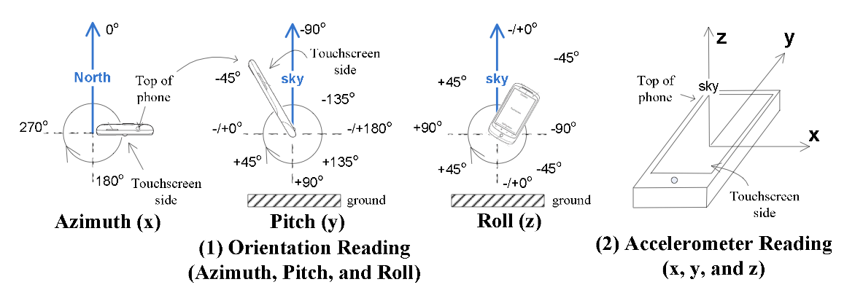

Slide 10
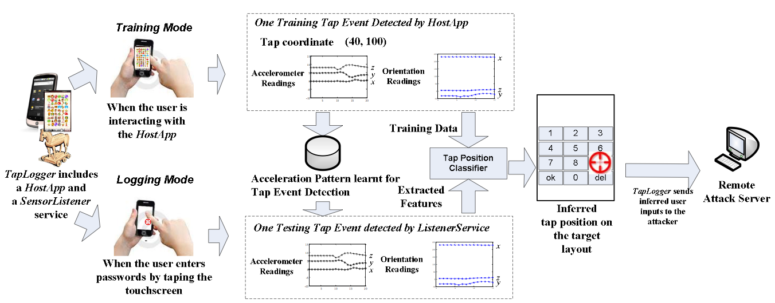

Slide 11
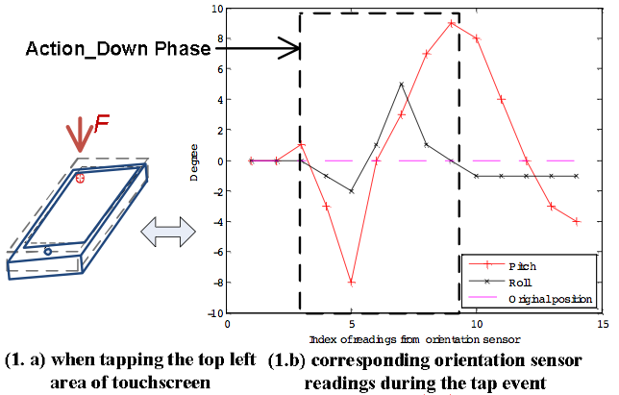
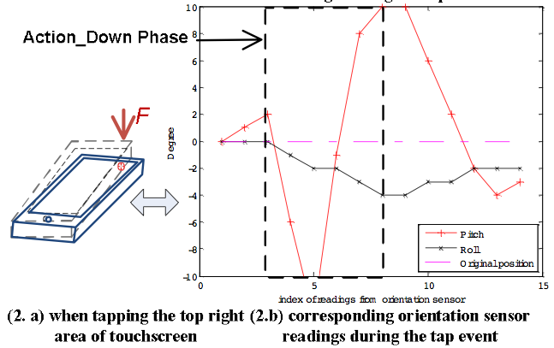

Slide 12
KISS: Programming Model of Map-Reduce
map (in_key, in_value) -> list(out_key, intermediate_value)
Processes input key/value pair
Produces set of intermediate pairs
reduce (out_key, list(intermediate_value)) -> list(out_value)
Combines all intermediate values for a particular key
Produces a set of merged output values (usually just one)
Inspired by similar primitives in LISP and other languages

Slide 13


Criticism: “MapReduce: A Major Step Backwards”
Prof. David DeWitt
Wisconsin University
Michael Stonebraker
CTO of Informix
Professor in MIT
Professor in UC Berkeley
Notes:
http://blog.csdn.net/nevasun/article/details/7590882

Slide 14
Criticism: “MapReduce: A Major Step Backwards”
A giant step backward in the programming paradigm for large-scale data intensive applications
A sub-optimal implementation, in that it uses brute force instead of indexing
Not novel at all — it represents a specific implementation of well known techniques developed nearly 25 years ago
Missing most of the features that are routinely included in current DBMS
Incompatible with all of the tools DBMS users have come to depend on
Well, these are all “the right things”, but…

Slide 15

After MapReduce
Hadoop
An open-source implementation of MapReduce
Again, very bad performance at first
But widely used!
Cassandra, Hbase, Hive, PIG, Spark, ZooKeeper, …
Keep being optimized by both academy and industry
Till today

Slide 16
CASE Study: ShellShock (Bash Attack)
What does KISS cost?

Slide 17
ShellShock Attack
Found by Stéphane Chazelas
CVE-2014-6271 & CVE-2014-7169

Slide 18
Bash Basic: Environment Variable
$ var="hello world”
$ echo $var
hello world
$ bash
$ echo $var
$
Define ‘var’ as a string
Print ‘var’
Start a new bash
No output in new bash

Slide 19
Bash Basic: Environment Variable
$ var="hello world”
$ echo $var
hello world
$ bash
$ echo $var
$
$ export var="hello world”
$ echo $var
hello world
$ bash
$ echo $var
hello world
$

Slide 20
Bash Basic: Define Function
$ foo(){ echo "hello world"; }
$ foo
hello world
$ bash
$ foo
bash: foo: command not found
$ foo(){ echo "hello world"; }
$ foo
hello world
$ export -f foo use export
$ bash
$ foo
hello world

Slide 21
Bash Basic
Each bash has different env variables
A child bash can see an env variable only if its parent uses export
A function is also a variable
Bash tells a function by “()”

Slide 22
The Vulnerability
export X='() { echo "inside X"; }; echo "outside X”;’
Define X
X is a function, which starts by ‘()’
$ export X='() { echo "inside X"; }; echo "outside X";'
$ bash
outside X

Slide 23
The Vulnerability
A function is defined in a var, which is exported
A child bash copies all of its parent’s env vars
The child will execute some code in a var during the copy!
$ export X='() { echo "inside X"; }; echo "outside X";'
$ bash
outside X
$ env
…
X=() { echo “inside X” }
…

Slide 24
The Vulnerability
env VAR='() { :;}; echo Bash is vulnerable!' bash -c "echo Bash Test”
‘:’ means ‘/bin/true’, which returns true and return
Now please explain this test by yourselves
What would be executed during bash forking?
What can an attacker do if she can define such VAR?
Notes:
Echo bash is vulnerable!

Slide 25
Why Big Deal?
On apache server, it is typical to fork a child process for each HTTP client
Use bash env variables a lot
A DHCP client may get malicious value from a malicious DHCP server
Notes:
https://securityblog.redhat.com/2014/09/24/bash-specially-crafted-environment-variables-code-injection-attack/

Slide 26
Hard to Fix
env X='() { (a)=>\' sh -c "echo date"; cat echo
‘(a)=‘ is to trigger an error
Then only ‘>\’ left in the buffer
Bash will then put ‘echo data’ in the buffer to execute
>\
echo date >echo date date >echo
Notes:
What about change echo to some other

Slide 27
Why ShellShock Ever Exist?
Three principles of UNIX programming ^{[1]}:
Write programs that do one thing and do it well
Write programs to work together
Write programs to handle text streams, because that is a universal interface
[1] http://en.wikipedia.org/wiki/Unix_philosophy

Slide 28
Interesting Shell
ls -l *.c
“ls”, “-l”, "*.c” # *.c =>“foo.c” “bar.c”
“ls”, “-l”, “foo.c” “bar.c”
What if a file with name “-l”?
>-1
Notes:
You can use ‘rm ./-l’ to remove the file.

Slide 29
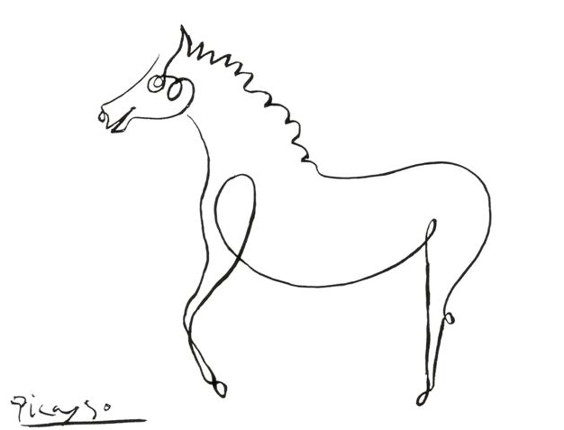

The Simpler, The Better?
No…
The point is: how to find a right way to be simple?

Slide 30
Previously on CSP
KISS in kernel
Case: micro-kernel VS. monolithic kernel
Case: Exokernel

Slide 31
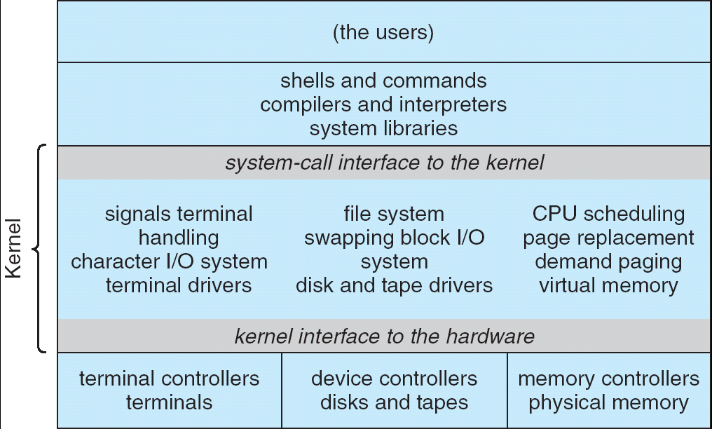
The Problem: Monolithic Kernel is Too Large

Slide 32
Micro-Kernel Came to the Rescue
Near-minimum amount of software that can provide the mechanisms needed to implement an operating system (OS)
Low-level address space management, thread management, and inter-process communication (IPC) and so on …
Mach, L4 kernel

Slide 33
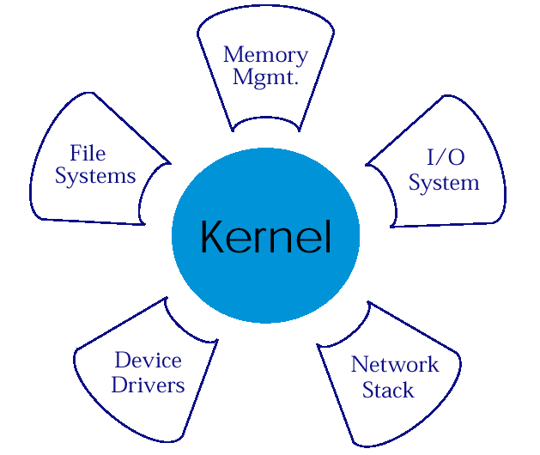
Microkernel Structure & Instances
APP1
APPn
LPC
APP2
APP4
HAL
APP3

Slide 34
Micro-Kernel
Moves as much from the kernel into “user” space
Communication between user modules using message passing
Benefits:
Easier to extend a microkernel
Easier to port the operating system to new architectures
More reliable (less code is running in kernel mode)
More secure
Detriments:
Performance overhead of user to kernel communication

Slide 35
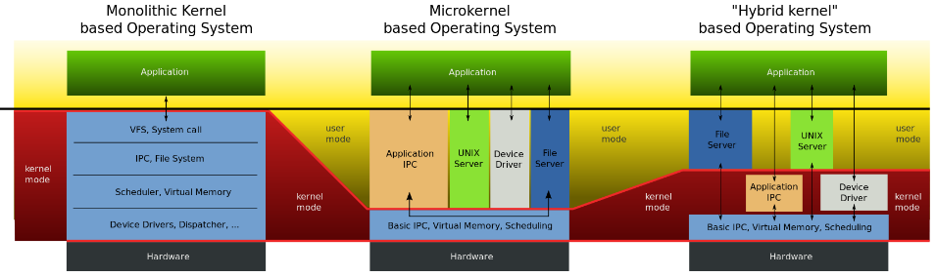
Comparasion

Slide 36
Exokernel on X86: XoK & ExOS

Slide 37
Traditional OS
Only privileged servers and the kernel can manage system resources
Both resource management & protection are done by kernel
Centralized control
Untrusted applications are limited to the interface
Limited functionality
Hurt application performance
Hide information (page fault etc.)

Slide 38
Traditional OS
An interface designed to accommodate every application must anticipate all possible needs
Flawed !
Solution:
Allow applications enough control over resources by separating protection from management
“Exokernel” does this
User process
User process
System calls
Kernel

Slide 39
Exokernel
Separates resource management from protection
Normal kernel does both
Kernel: only protect the resources
Application: manage the resources
Virtual memory, file system etc. are in application libraries
Gives untrusted software as much control over hardware and software resources as possible
Specialized applications can gain high performance without sacrificing the unmodified UNIX program

Slide 40
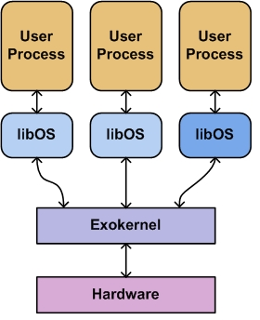
Exokernel: Example
Application manages its disk-block cache and kernel allows cached pages to be shared securely between applications
User space
Kernel space

Slide 41
Extensible OS
Extensibility lets new functionalities to be included in the OS
Let applications safely modify system behavior for its own need
Different approaches to extensible OS:
Exokernel (MIT)
SPIN (UW)
VINO (Harvard)
L4 (IBM)
Fluke/OSKit (Utah)

Slide 42
Three Real Exokernel Systems
XoK
For Intel x86 based computers
Multiplexes physical resources (disk etc.)
In this paper, Xok is used for the experiments
Aegis
Runs on MIPS based DECStations
Glaze
For the Fugu microprocessor

Slide 43
OS as a Library
“Unix as a library”
Can implement traditional OS abstraction
Most application programs will be linked to libOSes of their choices instead of communicating with the Exokernel
Unprivileged libraries
Can be modified or replaced at will
Different libOSes can coexist on the top of same Exokernel
Allows system to emulate behaviors of several conventional OSs

Slide 44
Exokernel Principles
Separate resource protection and management
Exokernel and libOSes
Minimum resource management as required by protection (allocation, revocation etc.)
Expose allocation
Applications allocate resources
Kernel allows the allocation requests
Expose names
Exokernels use physical names wherever possible
Expose revocation
Let application choose which instance of resource is to give up
Expose information
Expose all system info and collect data that application can not easily derive locally

Slide 45
Exokernel: Three Design Tech
Access control on all resources is uniform
Bind hardware together with software abstractions
Example: tie together buffer cache and physical memory
Allow downloaded code where necessary, and protect it
Example: files may require valid updates to their validation times

Slide 46
Exokernel: Protected Sharing Mechanism
Software regions
Areas of memory that can only be read or written through system calls
Hierarchically-named capabilities
Requires that these capabilities to be specified explicitly on each system call
Example: Buggy child process accidentally requesting write access to the parent’s page
Wake-up predicates
Wake up processes when arbitrary conditions become true
Robust critical sections
Implemented by disabling software interrupts

Slide 47
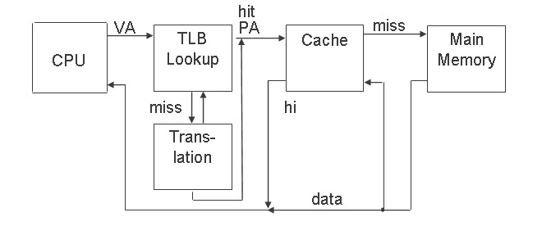
Review: TLB & Cache

Slide 48
ExoKernel’s Memory Protection
Using software TLB
ExoKernel manages the TLB
libOS manages the page table
Using page table only
libOS can read but not arbitrarily write the page table
Page table itself is set as read-only
Modification or changing of page table will trap to ExoKernel

Slide 49
Exokernel: Benefits
Exposing kernel data structure
Can be accessed without system call overhead
Flexibility
libOSes can be modified and debugged more easily
“Edit, compile, debug” cycle of applications is considerably faster than the “edit, compile, reboot, debug” cycle of kernel.
Performance
Aggressive applications may gain speed up to 10x

Slide 50
Exokernel: Drawbacks
Exokernel interface design is not simple
Most of the major Exokernel interfaces have gone through multiple designs over several years
The ease of creation and mixing of libOSes could lead to code messes
nightmare for maintenance coders and system administrators
It is theoretically possible to provide libOSes that enable applications to run simultaneously on the same system, that would also mean different look & feels for each of them.
Different libOSes may have varying levels of compatibility and interoperability
Poorly chosen abstractions may cause lose of information
Self-paging libOSes is difficult

Slide 51
Criticisms of Exokernel
Customer-Support:
“Extensibility has its problems. For example, it makes the customer-support issues a lot more complicated, because you no longer know which OS each of your customers is running” (Milojicic, 1999).

Slide 52
Conclusion
Exokernel Architecture:
Goal: safe application control of all resources
How: by separating resource management from protection
Results found promising:
Unmodified applications run same or 4x better
Customized applications can run up to 8x better
Global performance is similarly good like UNIX

Slide 53
Case: Xen
The art of virtualization

Slide 54
VMM, A Brief History
Virtual Machine Monitor: a software-abstraction layer that partitions the HW into one or more virtual machines
1960s: used for multiplexing the scarce general purpose computing platforms among multiple applications
1980s: multitasking OSes + low HW costs
Rendered VMMs obsolete
Consequently, no hardware support for virtualization in the CPU architectures of the time (e.g., x86)

Slide 55
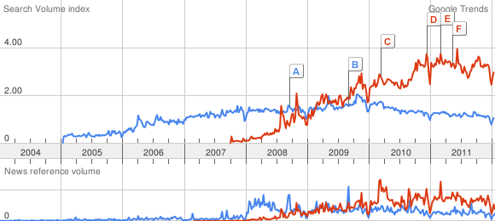
And Now…
Compared to “cloud computing” (in red)

Slide 56
Why This Revival?
Virtual Machine Monitor: a software-abstraction layer that partition the HW into one or more virtual machines
1960s: used for multiplexing the scarce general purpose computing platforms among multiple applications
1980s: multitasking OSes + low cost hardware
Rendered VMMs obsolete
2000s: multitasking OSes + low cost hardware
Revived VMMs

Slide 57
Challenges to Build Virtual Machines
Performance isolation
Scheduling priority
Memory demand
Network traffic
Disk accesses
Support for various OS platforms
Small performance overhead

Slide 58
Xen’s Goals
Multiplexes resources at the granularity of an entire OS
As opposed to process-level multiplexing
Price: higher overhead
Target: 100 virtual OSes per machine

Slide 59
Xen: Approach and Overview
Conventional approach
Full virtualization
Cannot access the hardware
Problematic for certain privileged instructions (e.g., traps)
No real-time guarantees

Slide 60
Xen: Approach and Overview
Xen: paravirtualization
Provides some exposures to the underlying HW
Better performance
Need modifications to the OS
No modifications to applications

Slide 61
Memory Management
Depending on the hardware supports
Software managed TLB
Associate address space IDs with TLB tags
Allow coexistence of OSes
Avoid TLB flushing across OS boundaries

Slide 62
Memory Management
X86 does not have software managed TLB
Xen exists at the top 64MB of every address space
Avoid TLB flushing when an guest OS enter/exist Xen
Each OS can only map to memory it owns
Writes are validated by Xen

Slide 63
CPU
X86 supports 4 levels of privileges
0 for OS, and 3 for applications
Xen downgrades the privilege of OSes
System-call and page-fault handlers registered to Xen
“fast handlers” for most exceptions, Xen isn’t involved

Slide 64
Device I/O
Xen exposes a set of simple device abstractions
One driver for each type of device
Network
Disk
Console
…

Slide 65
The Cost of Porting an OS to Xen
Privileged instructions
Page table access
Network driver
Block device driver
<2% of code-base

Slide 66
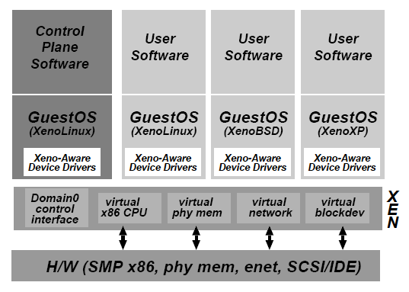
Control Management
Separation of policy and mechanism
Domain0 hosts the application-level management software
Creation and deletion
of virtual network
interfaces and block
devices

Slide 67
Control Transfer: Hypercalls and Events
Hypercall: synchronous calls from a domain to Xen
Analogous to system calls
Events: asynchronous notifications from Xen to domains
Replace device interrupts

Slide 68
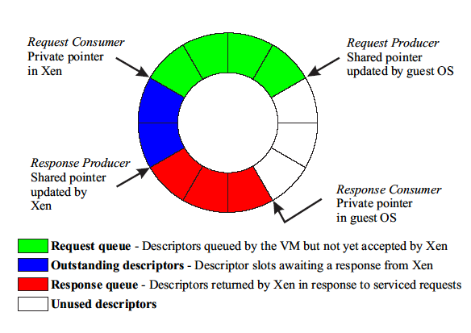
Data Transfer: I/O Rings
Zero-copy semantics

Slide 69
CPU Scheduling
Borrowed virtual time scheduling
Allows temporary violations of fair sharing to favor recently-woken domains
Goal: reduce wake-up latency

Slide 70
Time and Timers
Xen provides each guest OS with
Real time (since machine boot)
Virtual time (time spent for execution)
Wall-clock time
Each guest OS can program a pair of alarm timers
Real time
Virtual time

Slide 71
Virtual Address Translation
No shadow pages (VMWare)
Xen provides constrained but direct MMU updates
All guest OSes have read-only accesses to page tables
Updates are batched into a single hypercall

Slide 72
Questions: Xen and the art of virtualization
1. How does Xen support existing I/O device drivers?
2. How does Xen ensure I/O isolation? What happen if a VM wants to access block owned by another VM?
3. What is Intel VT-x? How does it change the design of Xen?

